Slide 1


Lecture3: Teacher NoorMustafaRajpar
Mastering the Insert Tab in Microsoft Word
A comprehensive guide to leveraging every feature for professional document creation.
This presentation will walk through each group of the Insert Tab, detailing its function and application.

Slide 2




Chapter 1: Pages Group
The Pages group is essential for structuring your document, providing quick ways to add covers, blank pages, and section breaks.
Cover Page
Blank Page
Insert a pre-formatted cover page template for a professional look.
Instantly add a new, empty page anywhere in your document.
Page Break
Force the text following the cursor to start on the next page.

Slide 3

Chapter 2: Tables Group
Tables are fundamental for organizing data and creating structured layouts within your document.
Insert Table
Draw Table
Draw or select the grid size for a new table.
Manually draw cells and borders for complex layouts.
Convert Text to Table
Quickly transform delimited text into a structured table.

Slide 4


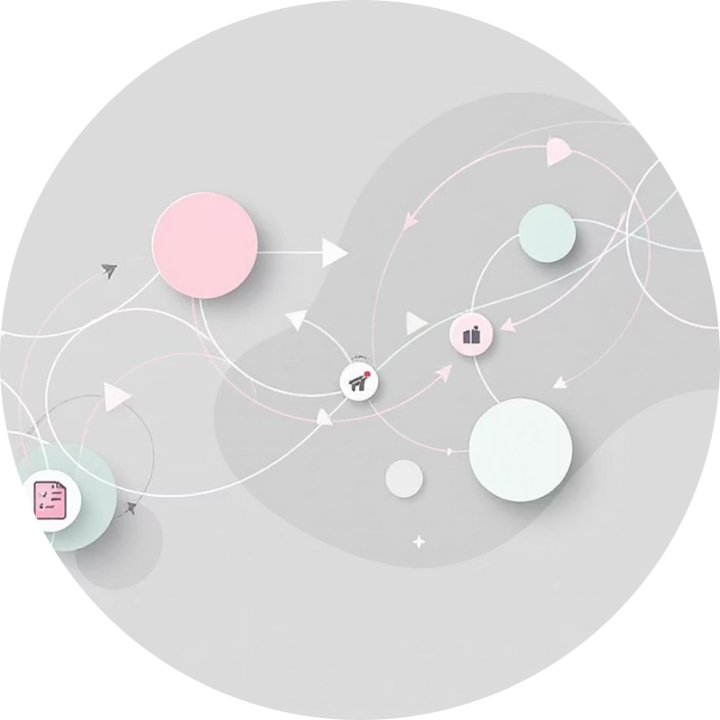

Chapter 3: Illustrations Group
Enhance visual communication by inserting various graphic elements. Visuals increase engagement and comprehension.
Pictures
Shapes & Icons
SmartArt
Chart
Insert images from your device or online sources.
Add geometric shapes, lines, and vector icons.
Use pre-designed graphics for lists, processes, and hierarchies.
Insert data visualizations like bar, line, or pie charts.

Slide 5

Chapter 4: Add-ins Group
Extend Word's functionality with third-party applications and tools.
Get Add-ins
Browse the Office Store for new tools to integrate into Word.
My Add-ins
Manage and use the add-ins you have already installed.

Slide 6

Chapter 5: Media Group
The Media group allows you to embed dynamic content directly into your document, primarily online videos.
Online Video
Insert videos from platforms like YouTube or Vimeo. The video will play directly within the document when viewed digitally.
This feature is crucial for interactive reports and digital manuals.
Embedding media transforms a static document into a rich, interactive experience.

Slide 7




Chapter 6: Links Group
Create connections within your document and to external resources using the Links group.
Link
Create hyperlinks to websites, files, or email addresses.
Bookmark
Mark specific locations in your document for easy navigation and cross-referencing.
Cross-reference
Refer to items like headings, figures, or tables elsewhere in the document.

Slide 8


Chapter 7: Comments Group
Facilitate collaboration and review processes by adding comments to specific sections of text.
New Comment
Insert a comment bubble to provide feedback or ask questions without altering the main text.
Comments are essential for tracking revisions and communicating with co-authors.
Use Comments for targeted feedback during the drafting phase.

Slide 9
Chapter 8: Header & Footer and Text Groups
These groups manage structural elements and specialized text boxes.
Header & Footer
Add recurring content (titles, dates) at the top or bottom of pages.
Page Number
Automatically number pages for easy reference.
Text Box
Insert movable, formatted text containers for sidebars or callouts.
WordArt
Apply decorative text styles for titles and emphasis.
Signature Line
Add a placeholder for a digital or physical signature.

Slide 10

Chapter 9: Symbols Group & Conclusion
The final group allows for the insertion of complex mathematical equations and special characters.
Equation
Insert complex mathematical formulas using pre-built structures or LaTeX.
Symbol
Access special characters not found on a standard keyboard (e.g., copyright, currency, foreign characters).
Key Takeaway
The Insert Tab is your gateway to enriching documents with structure, visuals, and dynamic content. Mastering these groups is essential for professional document design.

